Slide 1
How to Survive Grad School
Pandemic 2020 Edition
Hannah Joy Richter
6th Year, BMB, Lazar Lab

Slide 2
Disclaimers:
This year is a little different (But you know this already)
Every Ph.D. journey is different
You are all coming in with different expectations and experiences

Slide 3
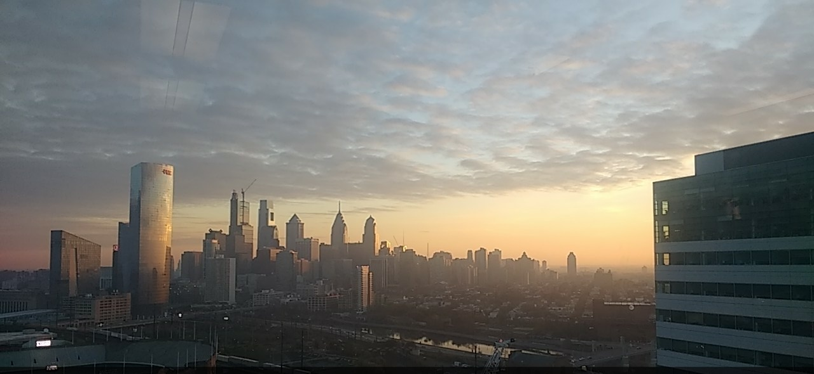
Welcome to Penn/Philadelphia!

Slide 4
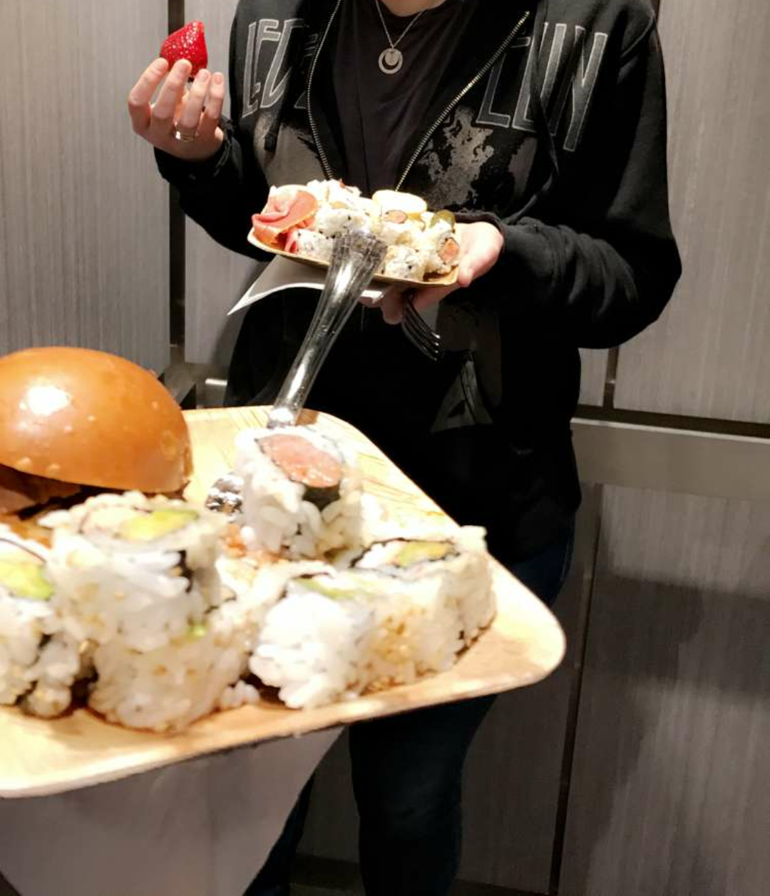
Sorry there’s no free food right now…
So here’s some free advice instead

Slide 5
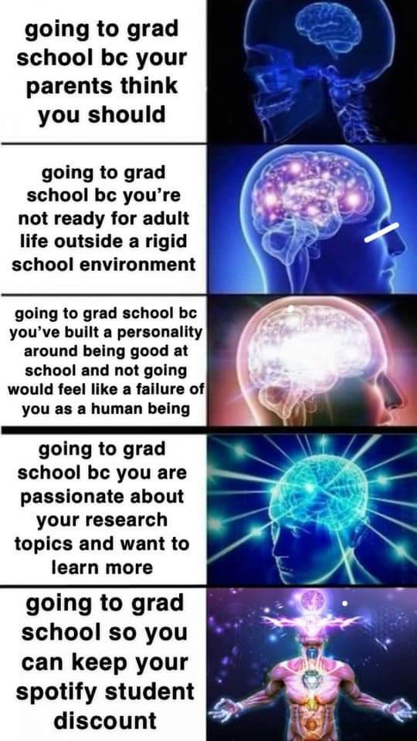
Remember why you’re here
Just say no to imposter syndrome
You are qualified, our admissions committees don’t make mistakes
You are ready to tackle this next scientific endeavor
You are at least a little bit passionate about science!

Slide 6
An outline for your first year
Classes
Rotations/choosing a lab
Tips for the rest of grad school

Slide 7
Classes: how to make the most of them
These are not undergrad courses; they are designed for you to learn not for you to grind and fail
Attend lectures (virtually)
Connect the themes to your research interests
Talk to TAs
Choose your optional courses wisely
Note that fellowships often require transcripts but are usually happy with a mix of As and Bs

Slide 8
Some ideas to consider about prospective labs
Field/methods: Be open to exploring new areas and learning new techniques
Lab environment: Collaborative, competitive, 9am-5pm, or nights and weekends
Size/age: Big/medium/small, pre-tenure/post-tenure
Funding: Your stipend is guaranteed! But always talk about how the lab handles reagent requests, model organisms, number of technicians, etc.
Prior trainees: How have they done and where have they gone?
Publication record: Does it match your expectations of yourself?

Slide 9
Key questions to ask your prospective PI
Are you looking to take on a thesis student? How many students will you take this year?
Do you have space and money available for a Ph.D. student?
  NIH RePORTER (http://projectreporter.nih.gov/reporter.cfm)
Will you be at Penn for the next 5-6 years? (if not tenured, or if being recruited somewhere else!)
What projects are available in your lab? (Rotations/thesis)
What is your mentoring style? How often do you travel normally?
What are your expectations for your graduate students?
What is the lab environment like?
Hours, lab jobs, lab meetings? journal clubs?
Can I see the lab space and meet your lab members?

Slide 10
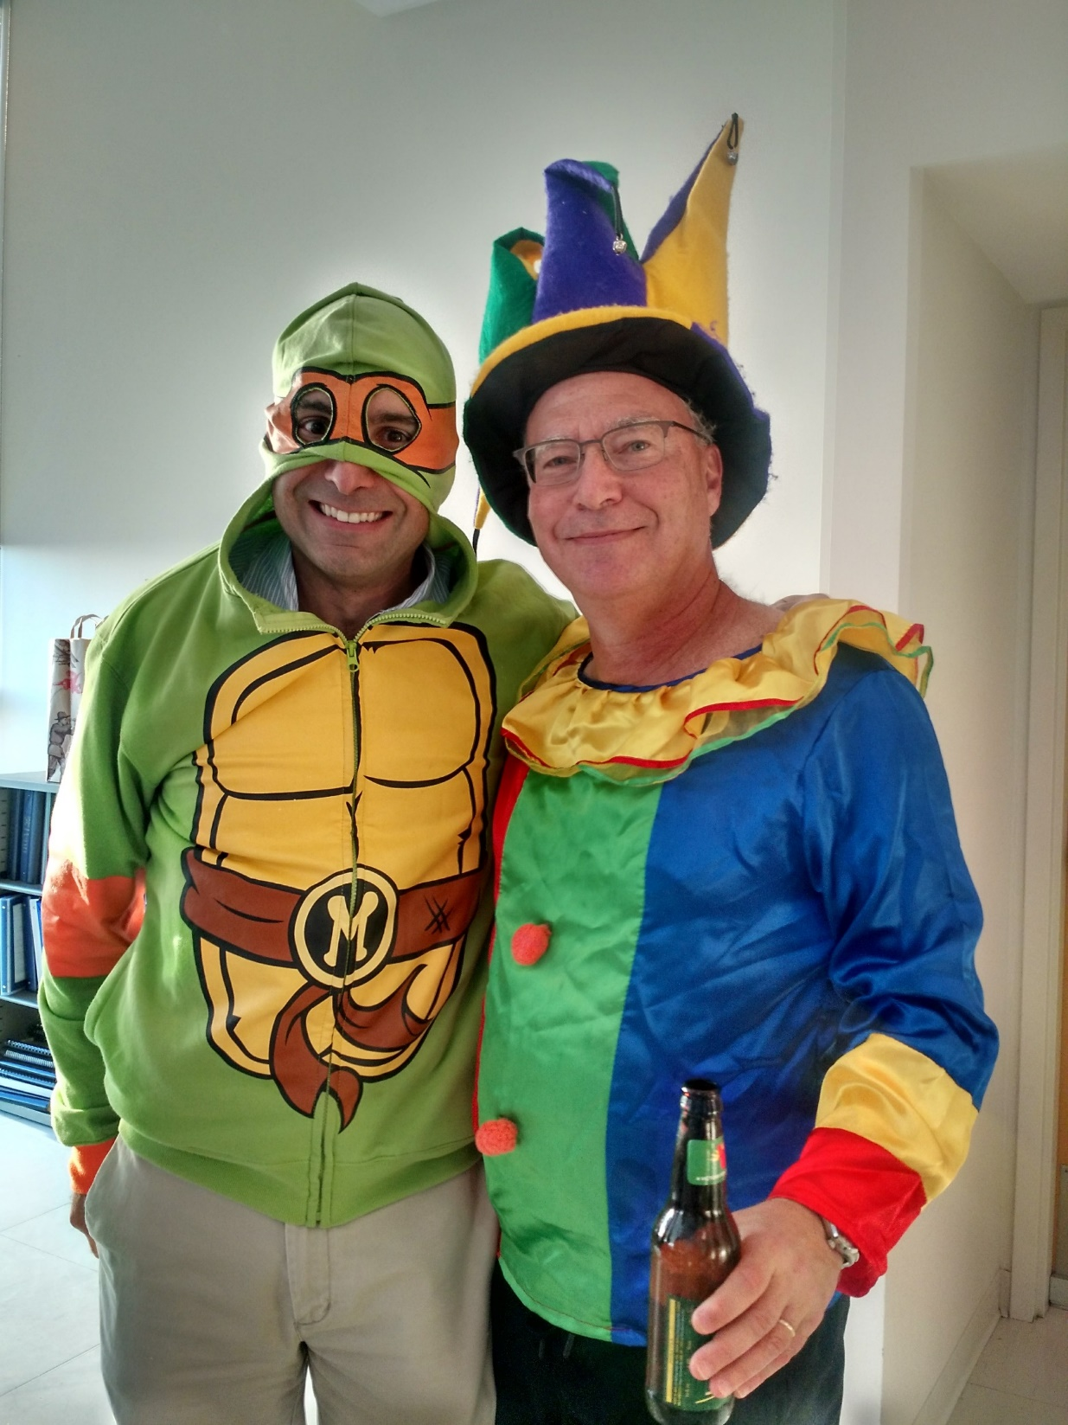
How to find a mentor who will help you succeed
Are your communication and work styles compatible?
  Emails
  Meeting frequency
  Hands-on/off
  Comfortable talking
Mentoring style
  Academia or bust?
  Willing to talk about life or just science?
  Conference attendance
  Help networking
Mentors outside of your PI
  Post-docs
  (Future) committee members
  Colleagues
  PIs at other institutions

Slide 11

Succeeding in your rotations
Remember, a rotation is for you to learn and to evaluate the lab as much as it is for the lab to evaluate you
Show up when you say you will (whether in-person or online)
Write down everything
Keep an up-to-date and thorough lab notebook
Get to know the other members of the lab
Know what you are doing and why
  Read the background papers!
  Ask questions!
This is you

Slide 12

Time management
Don’t overschedule yourself (even on BlueJeans)
Use a calendar! (Your choice, online/paper/what platform)
  It can be tough to keep track of all the meetings and seminars!
Block out time for reading and studying
Ask your lab mentor how long they expect experiments to take and block out a couple hours more than that
  Break up larger experiments into manageable blocks (this takes practice)
Block out time for YOU

Slide 13

Data management
BACK UP YOUR DATA
  External hard drives (if you can’t afford one, talk to your rotation lab about borrowing one or your program about technology grants)
  Cloud storage
    Penn+Box (FREE!) https://www.isc.upenn.edu/pennbox
    Google/Apple (not free for large amounts of data)
Find an organization method that works for you
  Talk to other grad students and post-docs about their methods (field-dependent)
  Don’t forget to keep track of negative data (even if you’re sad about it)

Slide 14

Keeping up with the literature
Make time to read, but use that time efficiently
  If you get over your head in a paper, ask for help!
  Read abstracts/glance over figures to decide what’s worth your time
Use a citation/pdf manager
  If you thought you could get away without one in undergrad, you need one now
    Endnote, Papers, Mendeley, Readcube, Zotero
Keep up-to-date with your chosen field
  PubCrawler, Google Scholar Alert, Readcube Recommendations, Twitter & other social media, BioRxiv

Slide 15
Fellowship applications
Talk to your PIs about their expectations for your funding
Training grants (T32) are a great experience – talk to your programs about what ones are available for you and their requirements
Individual fellowships – NSF and NIH (F31/F30) and other private foundations
  Keep in touch with your former PIs and do a good job in your rotations! (you’ll need the rec letters)
  Keep summaries of your undergraduate/technician/lab rotations
  Consider volunteering if you do not already!
  Keep an eye on deadlines and ask for what you need well in advance
  Talk to students who have applied to/gotten these fellowships

Slide 16
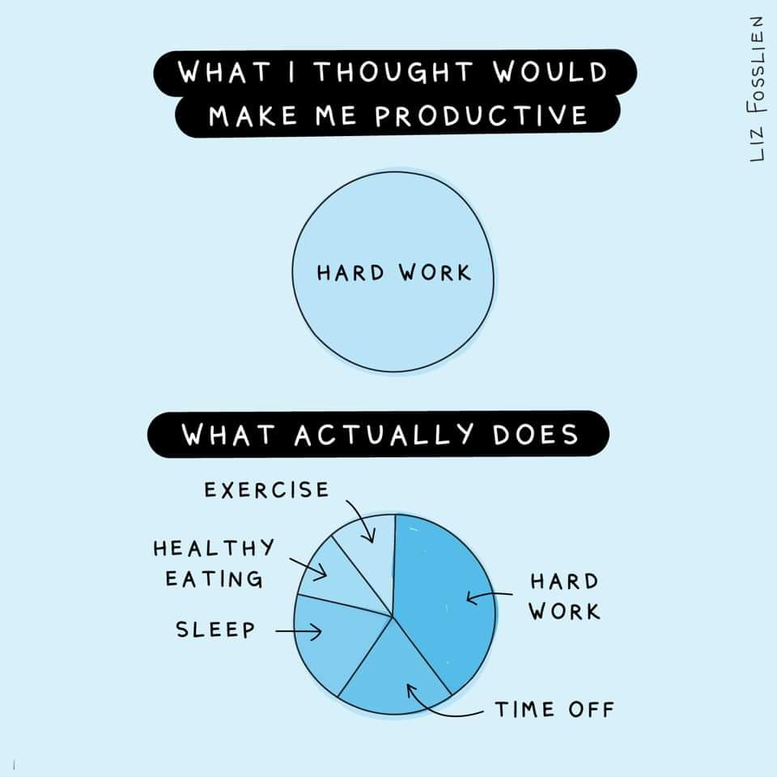
Productivity
Remember you are not a machine; you are a scientist in training
Set realistic expectations for yourself – this takes practice
Sleep, eat, exercise, relax
  VERY IMPORTANT
If you’re struggling, ask for help!

Slide 17
A note on finances
You are salaried – remember to give yourself vacations and weekends
This income is entirely livable in Philadelphia but you can’t go overboard on the essentials (housing, food, etc.) if you want to have fun money
  This is great time to make your first budget!
Taxes are complicated so take a look at the info provided by BGS for last year’s taxes for an example and talk to a professional
(I am not a financial advisor or tax professional)

Slide 18
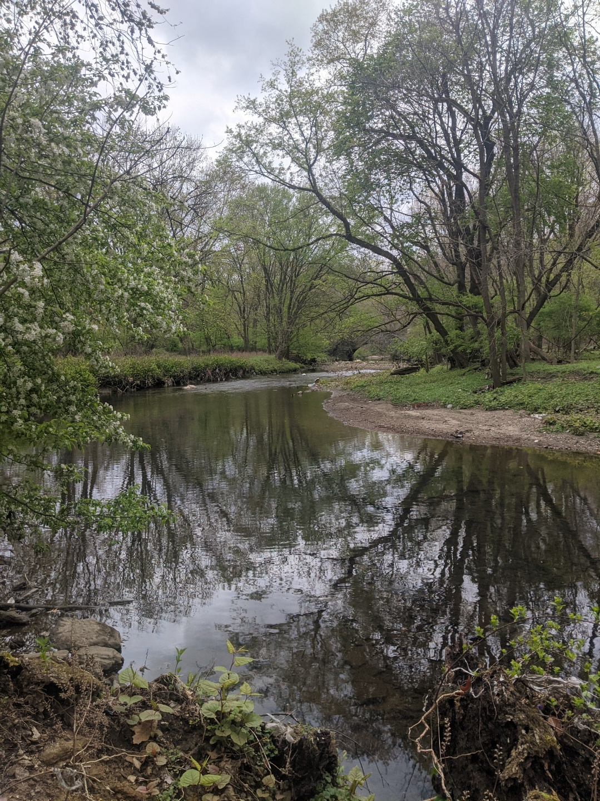
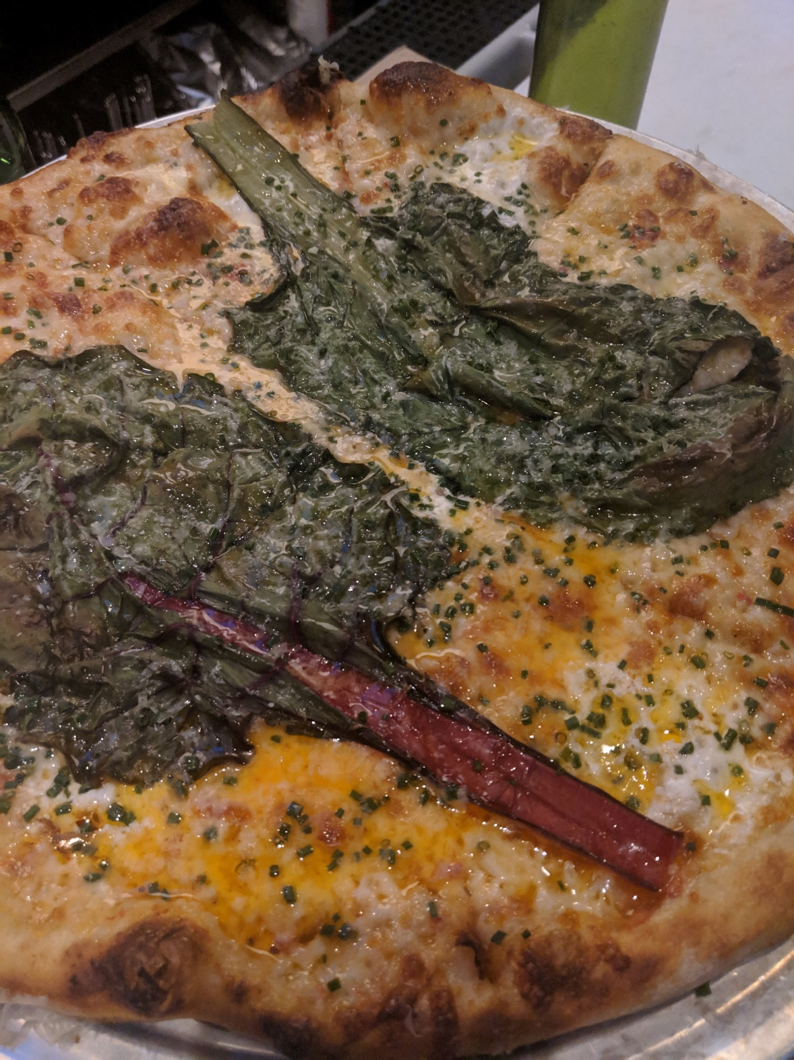
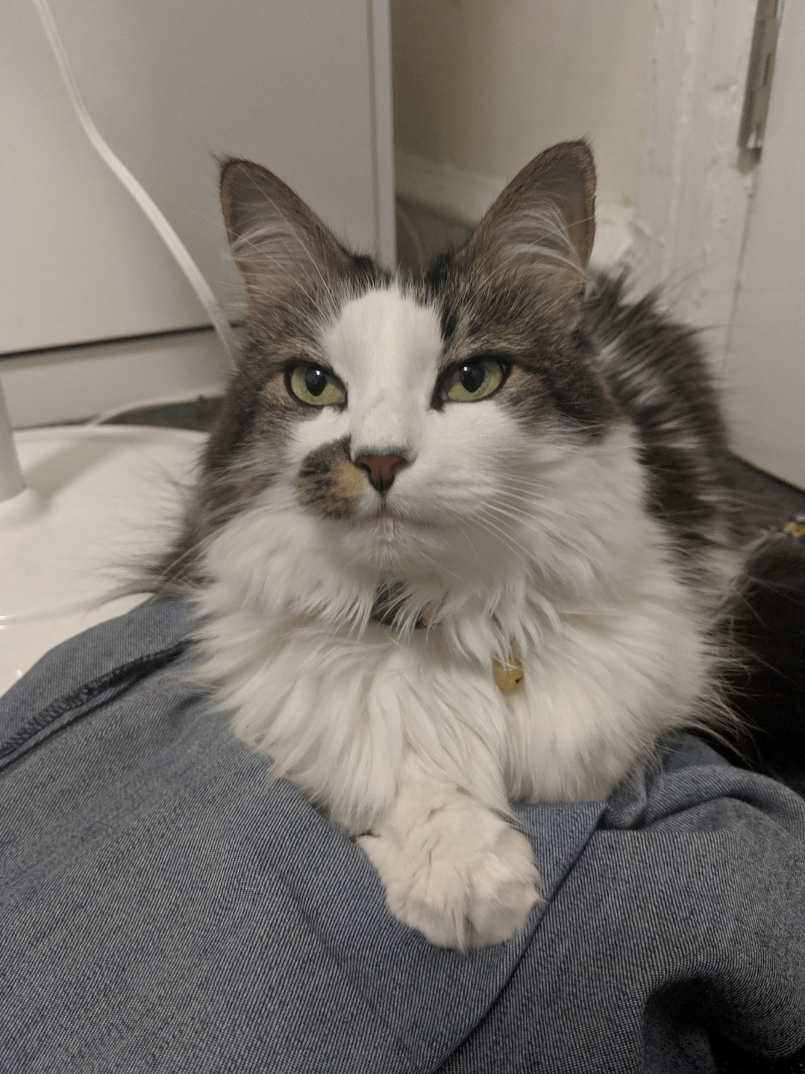
Having fun!
Cobbs Creek
Pets!
Pizzeria Beddia

Slide 19
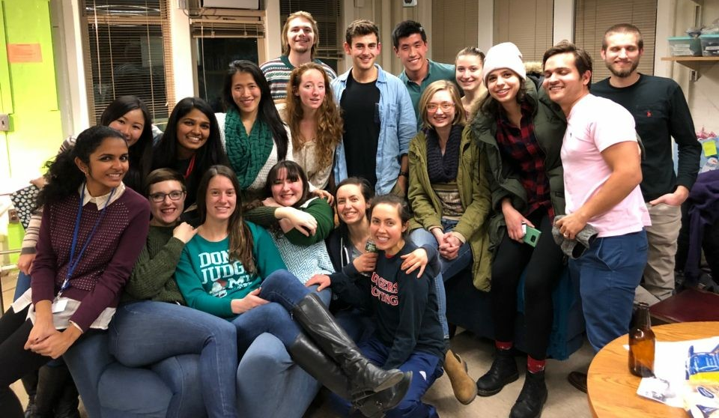
Your cohort will always understand your struggles

Slide 20
Take Home Messages
Remember to ask for help
Choose your mentor(s) wisely
Figure out systems for time and data management
Keep up with the literature
Work/life balance is key - make time for yourself and friends
A Ph.D. is still about learning
REMEMBER TO ASK FOR HELP

Slide 21
Some extra resources
“The importance of stupidity in scientific research” Martin A. Schwartz, Journal of Cell Science, 2008, 121:1771 http://jcs.biologists.org/content/121/11/1771
How to Complete and Survive a Doctoral Dissertation, Sternberg, David, N.Y.: St. Martin's Press, 1981
Getting What You Came For: The Smart Student's Guide to Earning a Master's or Ph.D., Peters, Robert L., N.Y.: Farrar, Strauss & Giroux, 1992
“Graduate School: the movie” Cori Bargmann, Current Biology, 1995, 5(7): 695
http://phdcomics.com/
Contact me on twitter @mdmpalindrome or by email richterh@pennmedicine.upenn.edu

